Slide 1
Revision and String Manipulation

Slide 2
Revision

Slide 3
Data Types
Float (Floating Point)
Double
Int (Integer)
Long
Short
Byte
String
Char (Character)
Bool (Boolean)
Variables galore!

Slide 4
Conditional Logic
if
or
and
not
Thinking like a computer

Slide 5
Arrays
Collections of data
Statically defined size
Any data type
Starts from index 0
Groups of data

Slide 6
Loops and Iteration
3 core types of loops
while
for
foreach
Easy way to run code more than once a frame
Can cause freezing
Doing things more than once

Slide 7
String Manipulation

Slide 8


IndexOf
Returns the index of the first found instance from the beginning of the string
Has ‘LastIndexOf’ counterpart which searches from the end instead
Example:

Slide 9
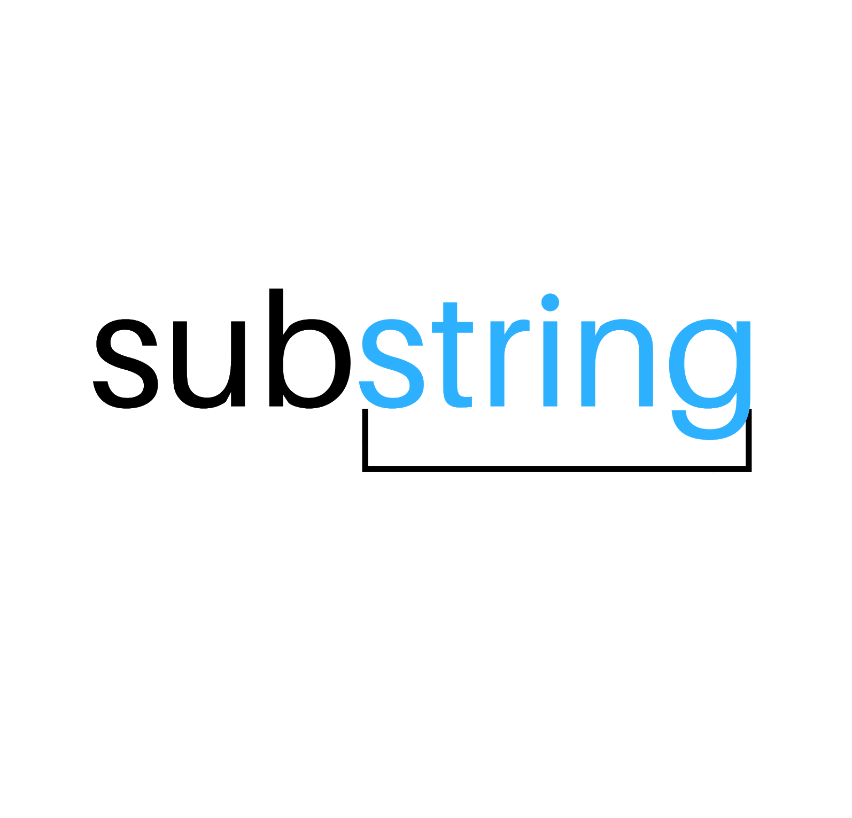


Substring
Gets part of a string based on index
Example:

Slide 10

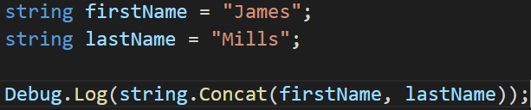

Concatenation
Joins two strings together
Example:

Slide 11

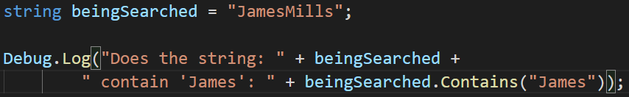

Contains
Searches the whole string
Example:

Slide 12
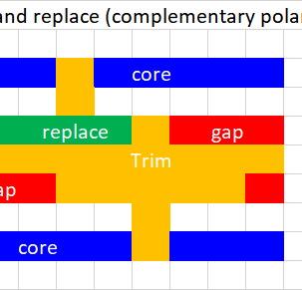
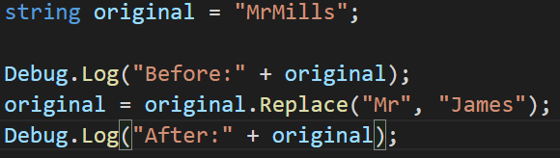

Replace
Searches the whole string for the first param, then replaces it with the second
Example:

Slide 13

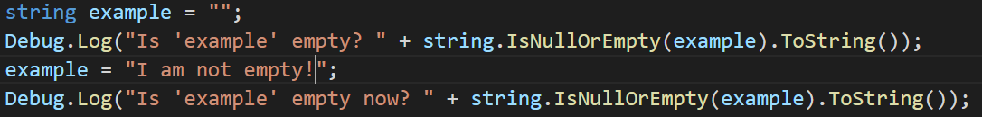

IsNullOrEmpty
Returns whether or not the string is an empty string or is not initialized.
Example:

Slide 14
Questions?

